Slide 1
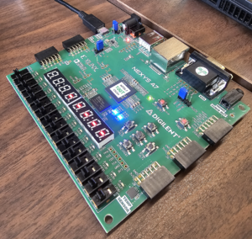

Hardware Design Workshop
Penn State IEEE
Fall 2026
Scan Attendance:

Slide 2
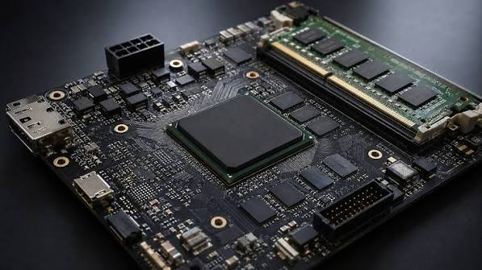
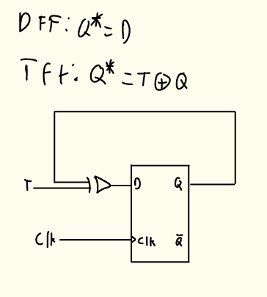
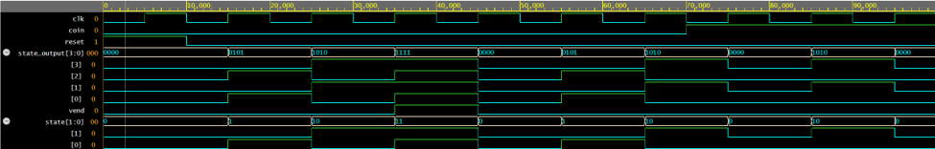
What is Verilog?
Commonly used in:
Field Programmable Gate Arrays (FPGA’s)
Application Integrated Circuits (ASICs)
Verilog is a hardware descriptive language (HDL) used to design and test digital circuits.
Digital Circuit simulation

Slide 3
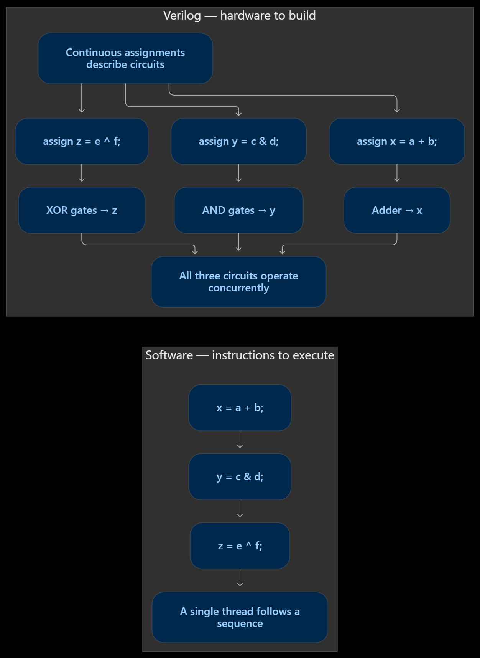
HDLs like Verilog describe hardware

Slide 4

More on HDLs
Many different flavors of HDLs
  Verilog, SystemVerilog, VHDL, Chisel, etc.
Used extensively to design chip logic and FPGAs
  Think CPUs, GPUs, etc.
  FPGAs => programmable digital circuits
In what industries can I apply these skills?
  Defense and aerospace
  Biomedical engineering
  Quant (WE are making BANKK)
  ‼️AI hardware‼️
    Always trying to make specialized processors

Slide 5
FPGAs and ASICs
Field Programmable Gate Arrays (FPGAs)
Application-Specific Integrated Circuits (ASICs)
Logic can be reconfigured after manufacturing
Try a design, change it, and try again
Lower upfront cost; useful for learning and prototyping
Typically uses more power and runs slower than an equivalent ASIC
Circuitry is fixed during manufacturing
Design and verify before fabricating the chip
High upfront cost; economical at large volumes
Typically more efficient and faster for the same task

Slide 6







Slide 7
What can I make with Verilog?
Computer chips
  Called soft processors
    RISC-V: a popular architecture used in embedded devices
Specialized hardware
  AI hardware
    Built on matrix multiplication -> very parallelizable
  Digital signal processing (DSP)
    Radars, antennas, etc.
  Quant (high frequency trading)
    Parsing market data to help traders make decisions
    Need to have nanosecond-level quickness

Slide 8
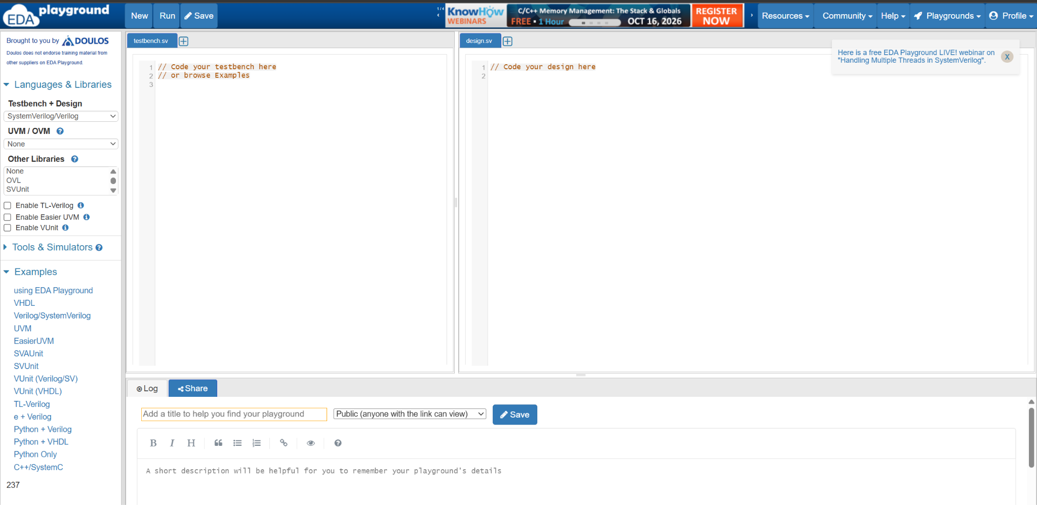
Where are we learning verilog?
We will be learning verilog through EDA playground:

Slide 9
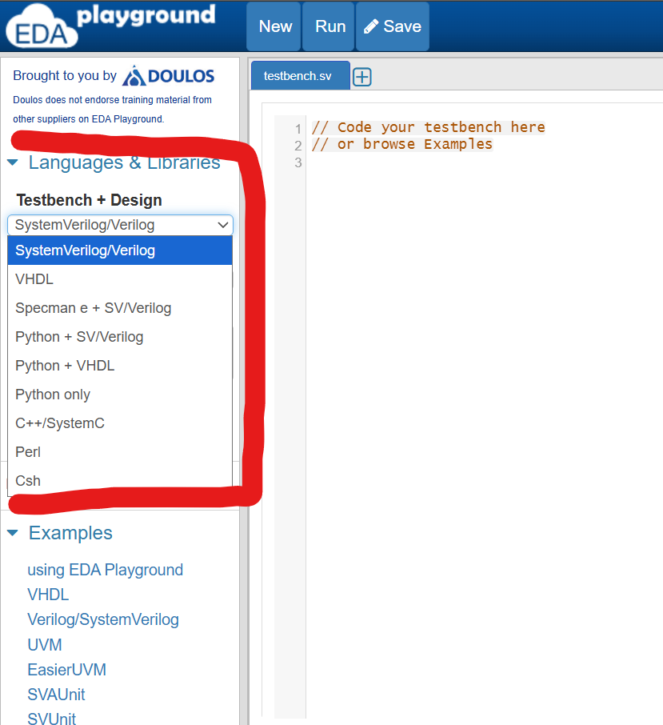
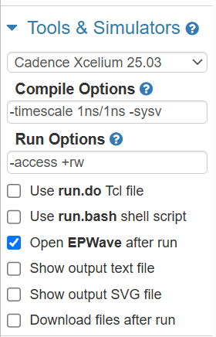
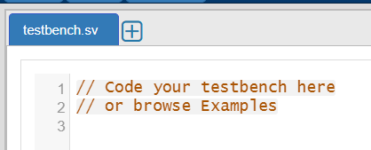
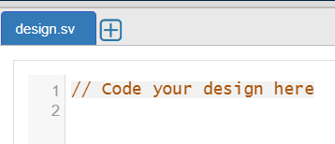
How to set up your EDA playground
Make sure you select “verilog”
Select Cadence Xcelium 25.03
Make sure you see a “testbench.sv” and a “design.sv”

Slide 10
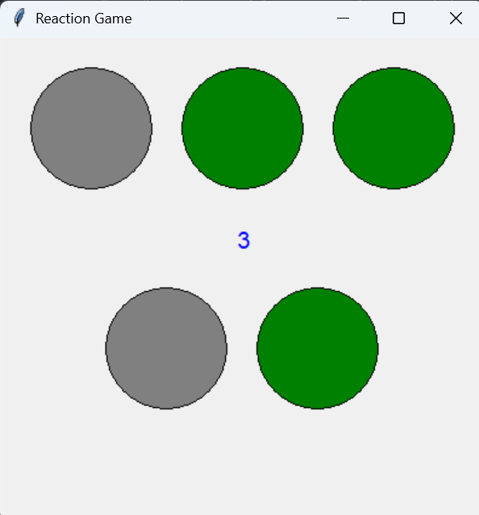
What will we be making?

Slide 11
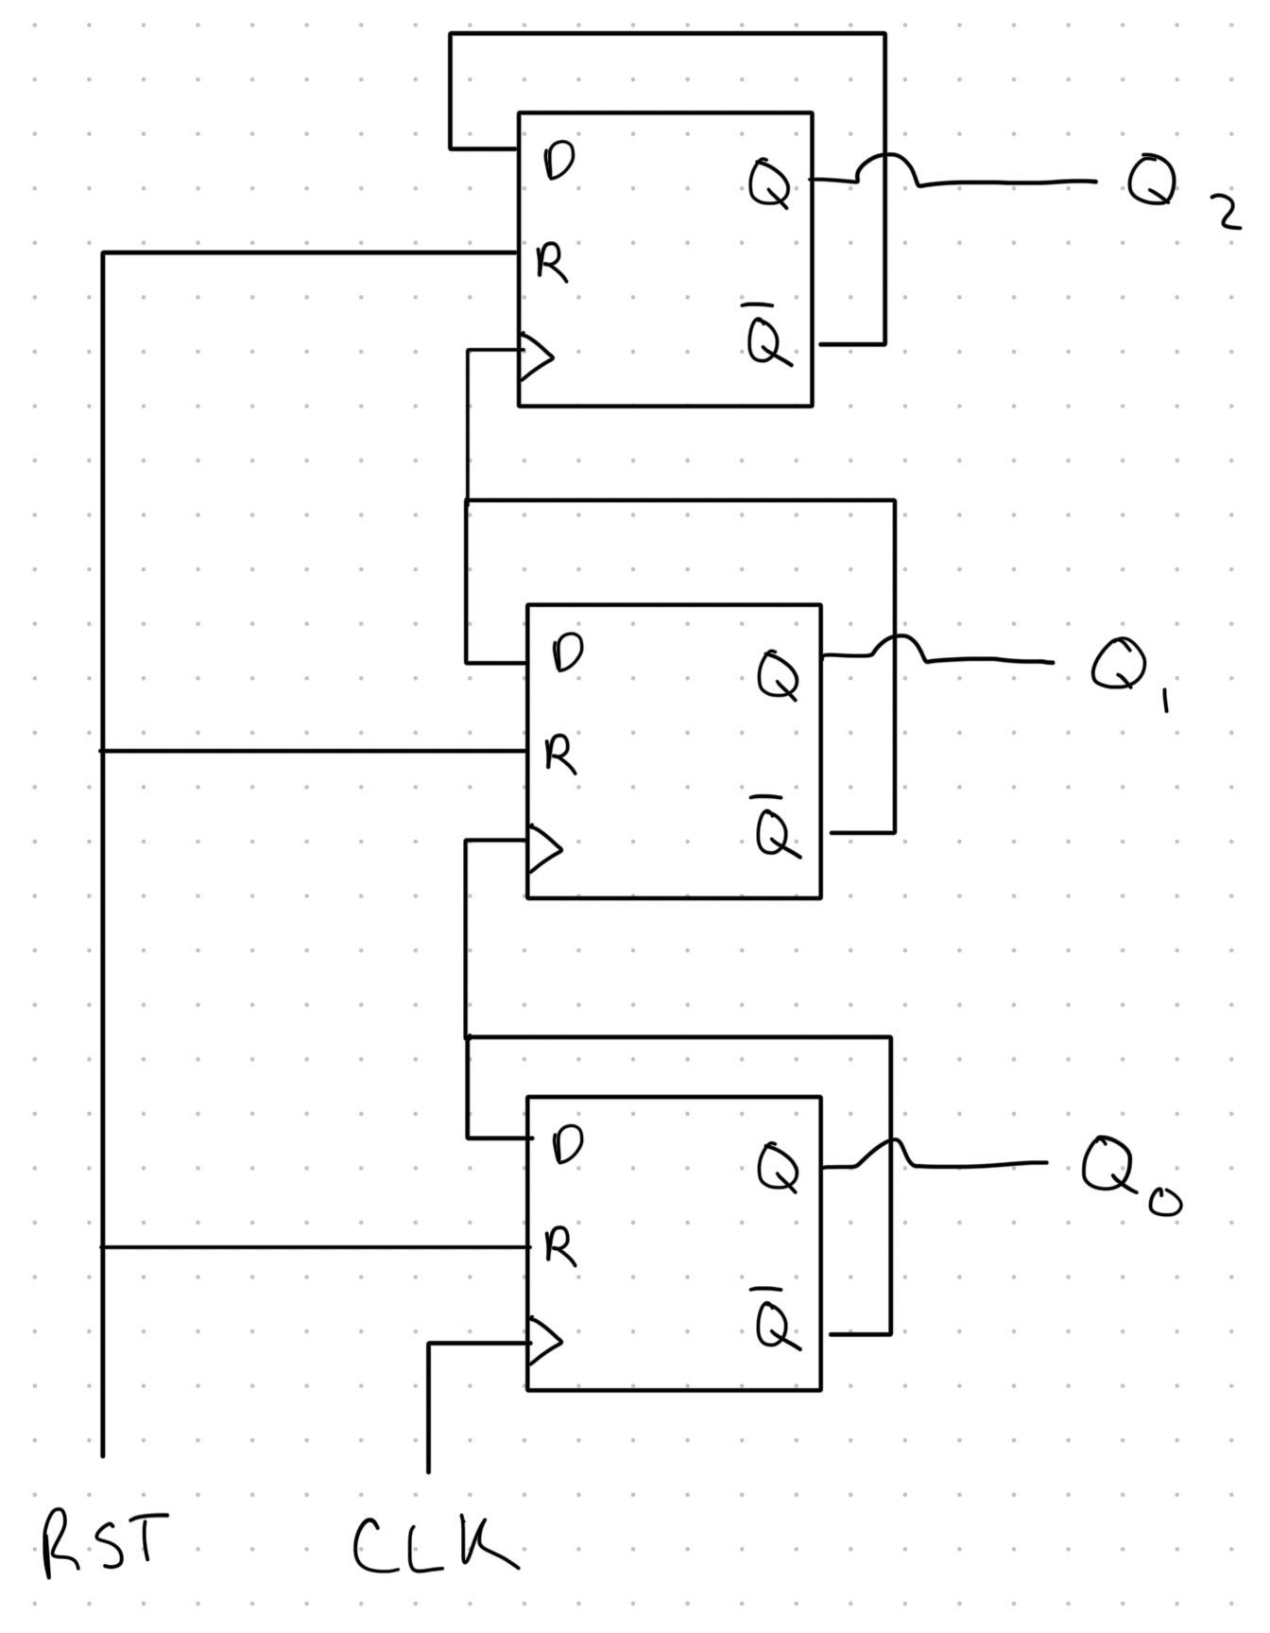
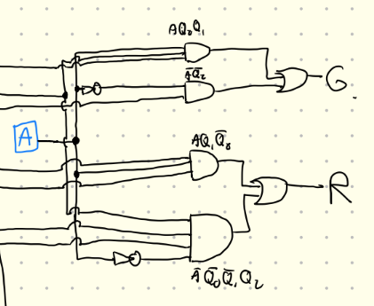
How will we be making this?
A 3 bit UP counter
A display

Slide 12
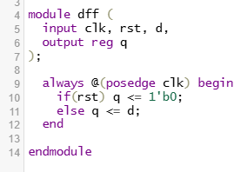
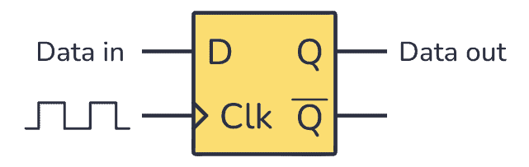
D Flip-Flop

Slide 13
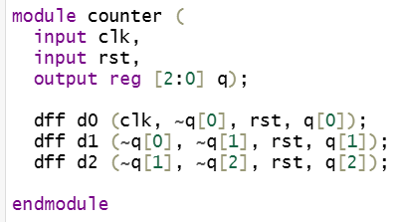
3 Bit UP counter
This is a circuit that counter in binary 0-7 (000->111)

Slide 14
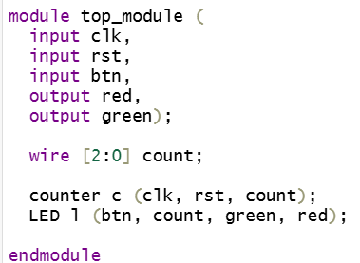
Top Module
We want something to hold the overall order of which we setup and run things so we only have to call one function to start the program, which in this case is our top_module

Slide 15
Display
Usually Verilog code is deployed straight to a FPGA or something similar as we learned earlier so we need another program to help us display this code on our computer.
For this Workshop we will be using cocotb in python to help us visualize the verilog code.
How to instal Cocotb on next slide ->

Slide 16
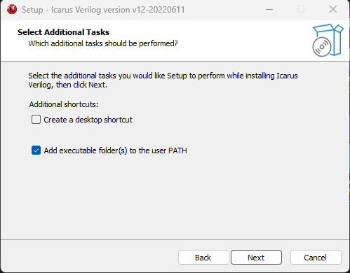
Cocotb
“pip install cocotb” in the terminal
https://bleyer.org/icarus/
Download V12
MAKE SURE TO CLICK ADD TO PATH

Slide 17
Thank you for attending the workshop!
Attendance in case you missed it earlier:

